Slide 1


AI DEEP DIVE & PROMPT ENGINEERING FUNDAMENTALS

Slide 2
MODULE AGENDA

Slide 3

Module Agenda
Key AI Components
AI Training Process
Practical Example: Build a simple AI
Fundamentals of Prompt Engineering
Prompt Engineering Techniques
Zero-Shot, Few Shot, & Chain of Thought
Key AI Terminologies: Self-Attention, GPT, Transformers
Embeddings
OpenAI API: System Vs. User Prompt, Temperature
Practical Example: Using GenAI for Financial Data Extraction
Practice Opportunity
© All rights reserved for Dr. Ryan Ahmed @Stemplicity Inc.

Slide 4
AI COMPONENTS & TRAINING PROCESS

Slide 5
Key AI Components
Data
Algorithms (Models)
Computing Power
© All rights reserved for Dr. Ryan Ahmed @Stemplicity Inc.
The foundation of AI, as it requires large amounts of data for training.
Mathematical models that process data to recognize patterns & make decisions.
Computational resources (e.g.: GPUs) to handle large datasets and run complex algorithms.

Slide 6


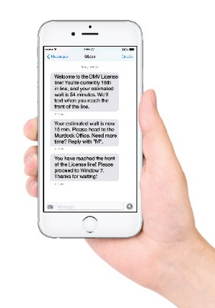


1. Data
Data can come from several sources and in various formats, such as images, audio, video, & text.
Collecting, structuring and analyzing this data is critical for companies to gain customers' insights and set their marketing and product strategies.
Image/Video
Text (Corpus)
Audio/Sound
Time Series/Signals
© All rights reserved for Dr. Ryan Ahmed @Stemplicity Inc.
Photo Credit: https://pxhere.com/en/photo/1454351
Photo Credit: https://www.flickr.com/photos/29881930@N00/2086641598
Photo Credit: https://commons.wikimedia.org/wiki/File:Mobile_phone_text_messages.jpg
Photo Credit: https://en.wikipedia.org/wiki/File:Messages_Yosemite.svg
Photo Credit: https://www.pexels.com/photo/blue-and-yellow-graph-on-stock-market-monitor-159888/

Slide 7
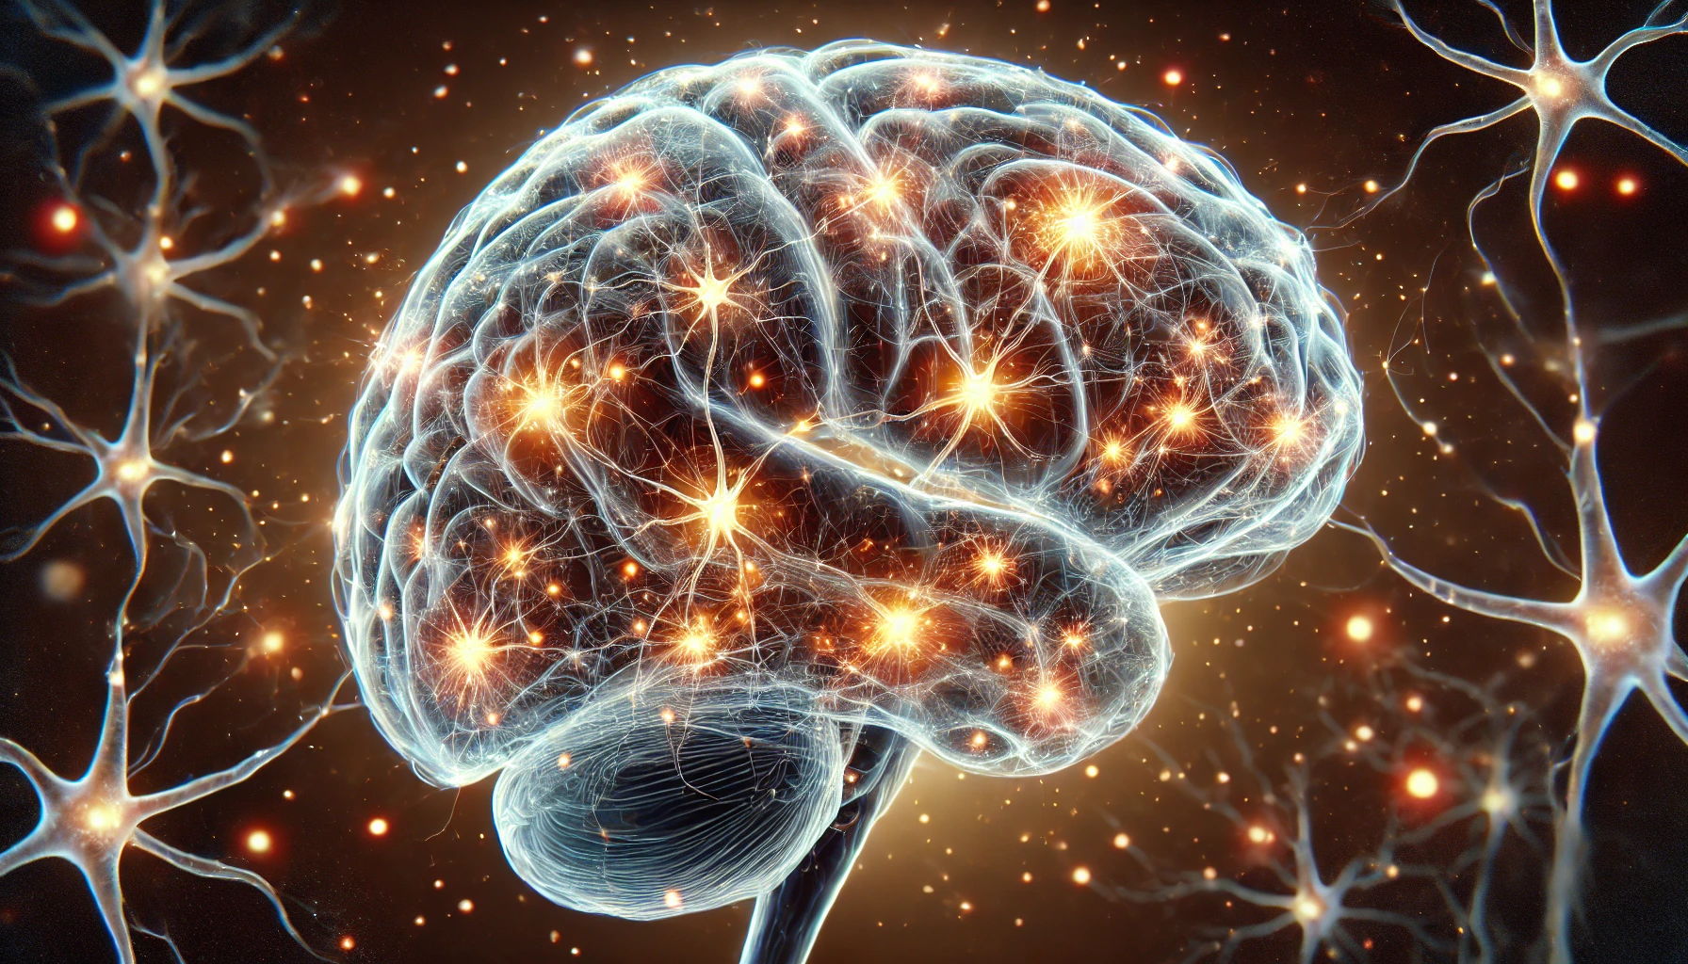
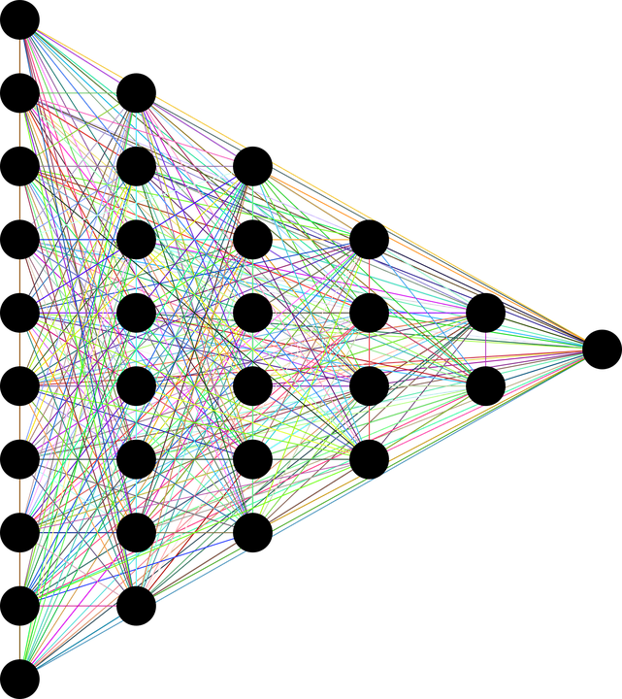
2. Model
The human brain consists of billions of neurons that communicate with each other using electrical/chemical signals and enable humans to see, feel, and make decisions.
Artificial neural networks (ANNs) are information-processing models inspired by the human brain and can mimic human intelligence.
Human (Natural) Neurons
Artificial Neurons
INPUTS
© All rights reserved for Dr. Ryan Ahmed @Stemplicity Inc.
OUTPUTS
Photo Credit: https://pixabay.com/en/neural-network-thought-mind-mental-3816319/

Slide 8
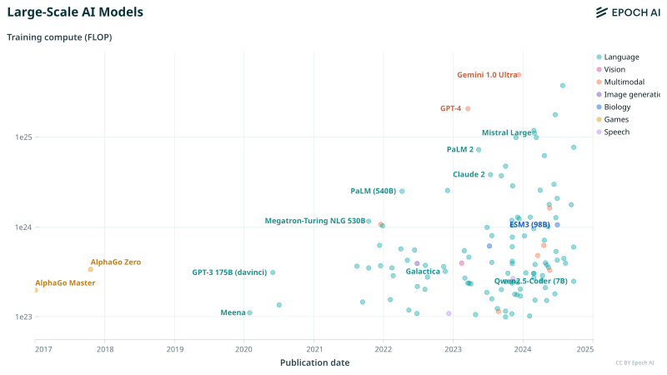
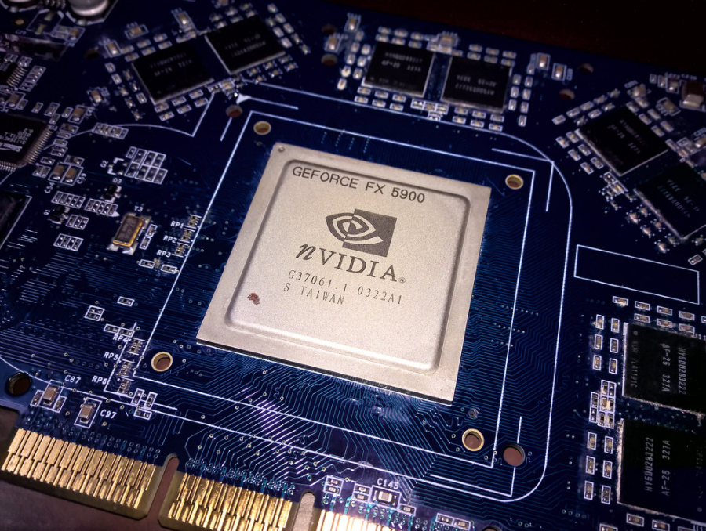
3. Computing Power
Training AI models leverage the power of Graphics Processing Units (GPUs), specifically designed for parallel processing and can significantly accelerate training times.
Analysis of machine learning model training compute since 1950 reveals three distinct eras: pre-Deep Learning, Deep Learning, and Large-Scale.
Since 2010, training compute has increased 10 billion-fold, doubling every 5-6 months.
Check this out: https://epoch.ai/blog/compute-trends
© All rights reserved for Dr. Ryan Ahmed @Stemplicity Inc.
Photo Credit: https://commons.m.wikimedia.org/wiki/File:Large-scale_AI_training_compute_%28FLOP%29_vs_Publication_date_%282017-2024%29.svg
Photo Credit: https://www.flickr.com/photos/3336/27830149309

Slide 9
AI TRAINING PROCESS

Slide 10
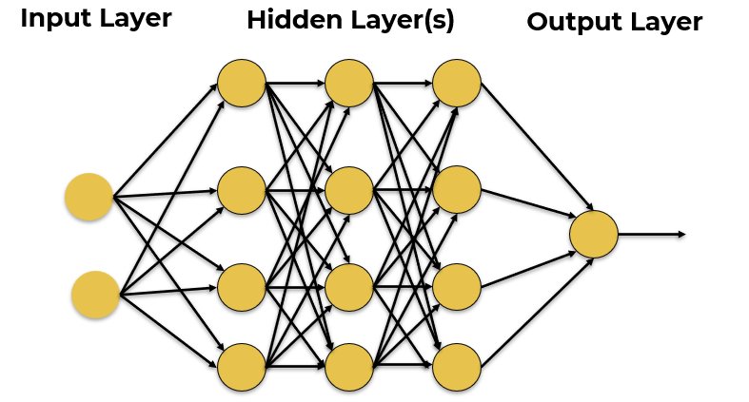
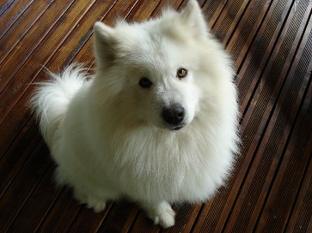


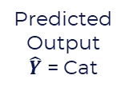
AI Training Process
Training Dataset
Inputs
Predicted
Output
$\hat{Y}$ = Cat
Desired Output $Y$
Label = Dog
© All rights reserved for Dr. Ryan Ahmed @Stemplicity Inc.
Error = $\hat{Y}−Y$
Update Network Weights
Photo Credit: https://commons.wikimedia.org/wiki/File:My_dog.jpg

Slide 11
GPT-3 Vs. GPT-4 Model Parameters
© All rights reserved for Dr. Ryan Ahmed @Stemplicity Inc.
GPT-3
175,000,000,000
GPT-4
100,000,000,000,000

Slide 12
PRACTICAL EXAMPLE: BUILD A SIMPLE AI MODEL

Slide 13
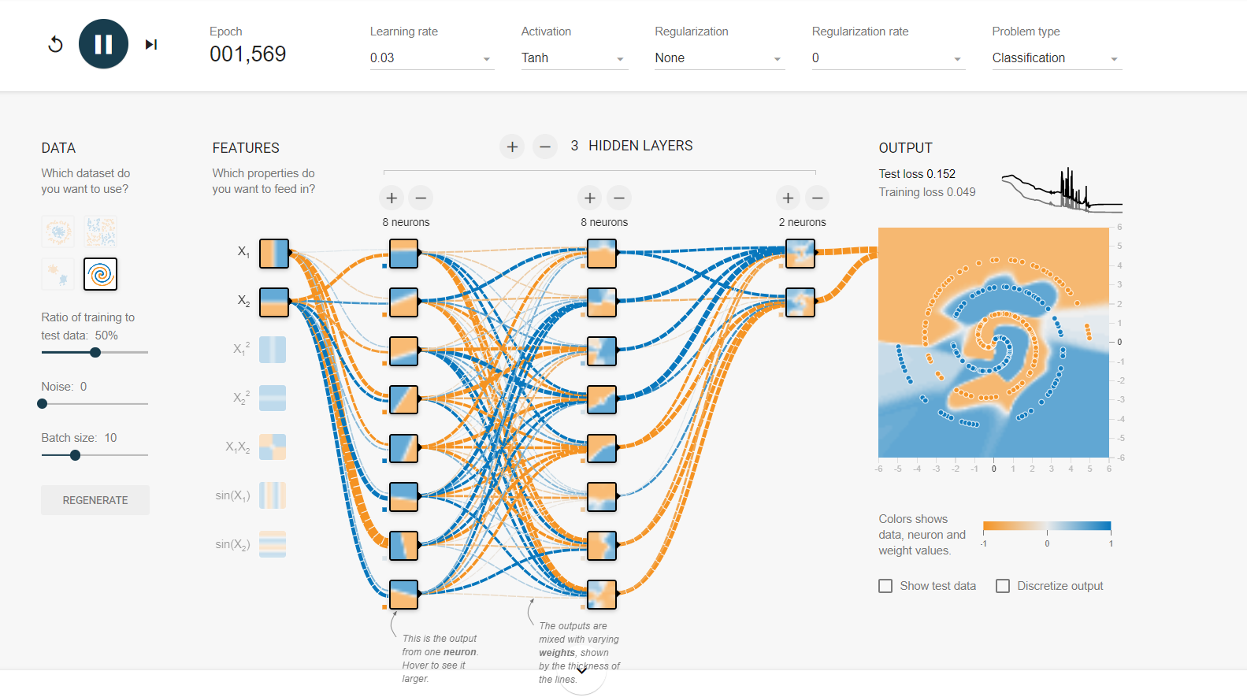
Let’s build an AI in Google Tensorflow Playground
https://playground.tensorflow.org/
© All rights reserved for Dr. Ryan Ahmed @Stemplicity Inc.

Slide 14
PRACTICE OPPORTUNITY

Slide 15

Practice Opportunity
Using Google Tensorflow Playground, perform the following tasks:
Choose 80%/20% training vs. testing data split.
Select a high-level noise ~30
Set the batch size to 20
Select the spiral dataset as an input
Modify the network architecture
Tune the network hyperparameters.
Assess network performance and comment on your results.
© All rights reserved for Dr. Ryan Ahmed @Stemplicity Inc.

Slide 16
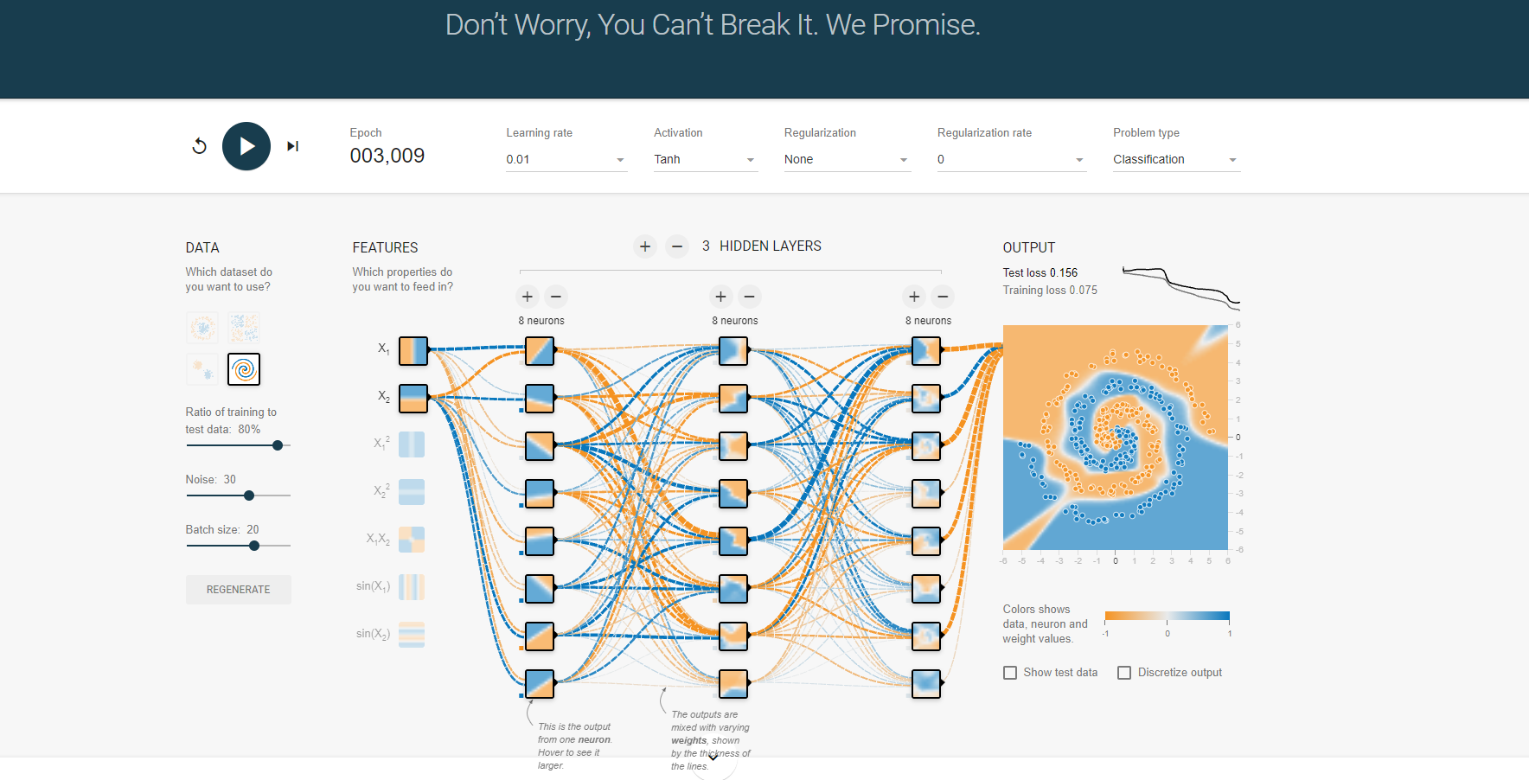
Practice Opportunity Solution
© All rights reserved for Dr. Ryan Ahmed @Stemplicity Inc.

Slide 17
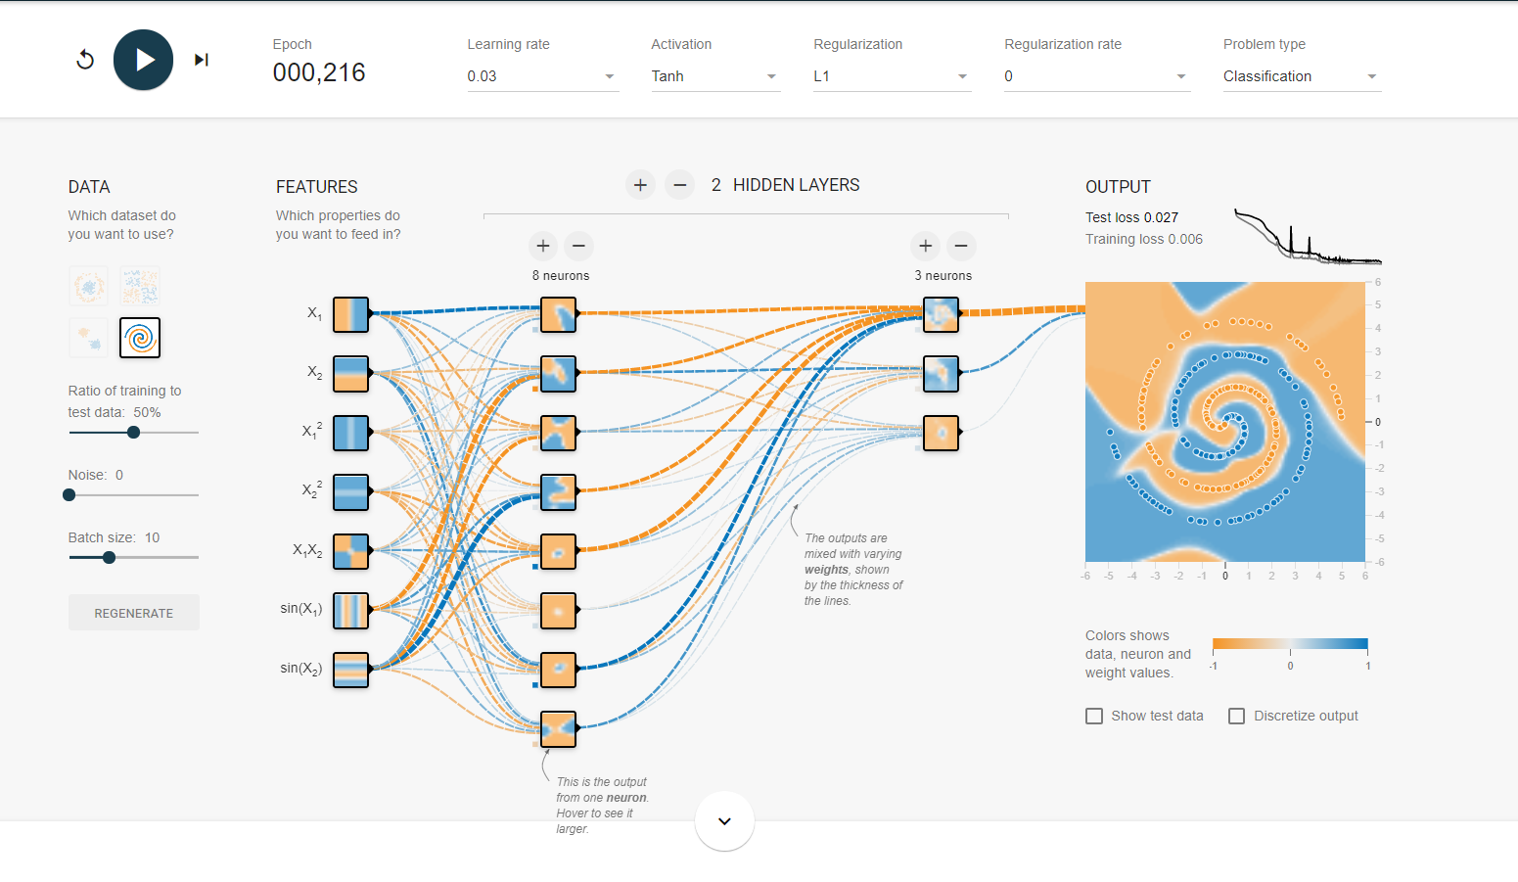
Practice Opportunity Solution
© All rights reserved for Dr. Ryan Ahmed @Stemplicity Inc.

Slide 18
PROMPT ENGINEERING FUNDAMENTALS

Slide 19
What is Prompt Engineering?
Prompt engineering is the practice of designing and optimizing text input to generative AI models to obtain desired responses.
It is the art of communicating with a generative AI model.
“Recommend a book.”
High-quality prompts guide the AI model to generate better outputs.
“Recommend a fiction book.”
© All rights reserved for Dr. Ryan Ahmed @Stemplicity Inc.
“Recommend a historical fiction book set in World War II.”

Slide 20
Prompt Components
Context: background knowledge to help the model understand the domain.
Assume that you are an expert financial analyst
Classify the following text as positive, neutral, or negative
Text: “Apple stock increased by 2% in today's trading session”
Sentiment:
Instruction: A clear statement of the desired goal.
Context
Input Data: The data the model needs to process to produce output.
Instruction
© All rights reserved for Dr. Ryan Ahmed @Stemplicity Inc.
Output Indicator: tells the model the format of the output.
Input Data
Output Indicator

Slide 21
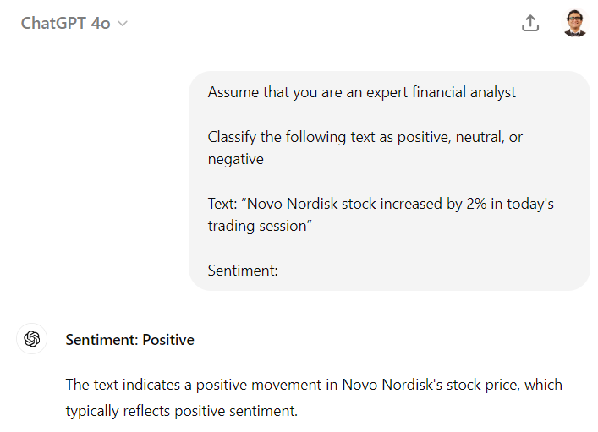
Prompt Engineering Example
© All rights reserved for Dr. Ryan Ahmed @Stemplicity Inc.

Slide 22

Prompt Engineering Techniques: Zero-Shot Prompting
Zero-shot prompting refers to the ability of a generative AI model to generate responses without being provided with any prior examples.
The model relies on its broad general knowledge learned from its training data to complete the task.
User prompt:
“Tell me the sentiment of the following headline and categorize it as either positive, negative or neutral:
New airline between Seattle and San Francisco offers a great opportunity for both passengers and investors.”
Generative AI model
© All rights reserved for Dr. Ryan Ahmed @Stemplicity Inc.
Output:
Positive

Slide 23
Prompt Engineering Techniques: Few-Shot Prompting
Few-shot prompting (in-context learning) involves providing a few example pairs of input and desired output to the generative AI model to guide its responses.
User prompt:
“Tell me the sentiment of the following. Here are some examples:
Apple stock declined 2% today
Answer: Negative
Tesla stock gained 5% after successful self-driving demo
Answer: Positive
OpenAI expanded its userbase to 100 million
Answer:”
Generative AI model
Output:
Positive
© All rights reserved for Dr. Ryan Ahmed @Stemplicity Inc.

Slide 24
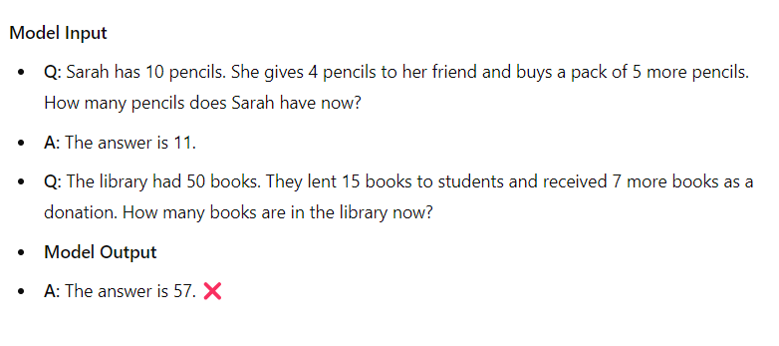
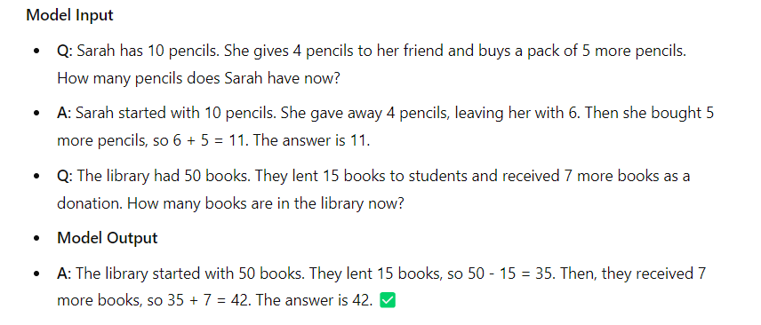
Prompt Engineering Techniques: Chain-of-Thought
Chain-of-thought prompting is a technique that improves the reasoning abilities of AI models by breaking down complex questions or tasks into smaller manageable steps.
It mimics how humans' reason and solve problems by systematically breaking down the decision-making process.
Standard Prompting
Chain-of-thought Prompting
© All rights reserved for Dr. Ryan Ahmed @Stemplicity Inc.

Slide 25
KEY AI TERMINOLOGIES

Slide 26
What is GPT?
GPT stands for Generative Pre-trained Transformer. It is an AI model designed to generate human-like text based on the input it receives.
Generative:
Refers to the model's ability to generate new, coherent text. It predicts the next word based on the context of the input text.
Pre-trained:
The model is trained on a large dataset from various sources (books, articles) before it is fine-tuned for specific tasks. Pre-training enables it to understand grammar and facts.
Transformer:
A transformer is a type of neural network that processes sequential data. It uses self-attention to weigh the importance of words, enabling it to understand context.
© All rights reserved for Dr. Ryan Ahmed @Stemplicity Inc.

Slide 27
What is Self Attention?
Self-attention is a way for a model to figure out which words in a sentence are most important when trying to understand the meaning or make predictions.
Example: Imagine you're reading the sentence: "The cat, which was hungry, chased the mouse."
If you're trying to figure out what "chased" is about, your brain automatically focuses on "cat" and "mouse," not "was hungry." This "focusing" is like self-attention.
The model does something similar—it assigns a weight to each word to decide how much attention it should pay to that word when understanding the sentence.
In simple terms, self-attention helps the model know which words to "pay attention to" at different points, depending on what it's trying to learn or generate.
© All rights reserved for Dr. Ryan Ahmed @Stemplicity Inc.

Slide 28
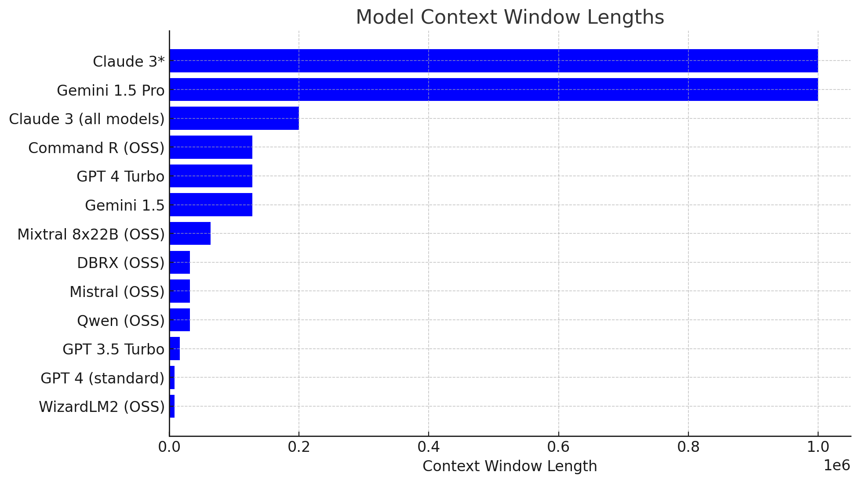
What is a Context Window?
The context window is the maximum number of tokens the AI model can process at a time, including both the input tokens (your prompt) and output tokens (the model's response).
Context Window Size:
GPT-3.5: About 4,096 tokens (~3,000 words).
GPT-4: Up to 32,000 tokens (~24,000 words), depending on the version.
GPT-4.o: 128,000 tokens
© All rights reserved for Dr. Ryan Ahmed @Stemplicity Inc.
Compare context window here: https://platform.openai.com/docs/models

Slide 29
KEY AI TERMINOLOGIES – TRANSFORMERS

Slide 30

What is a Transformer?
The transformer architecture is an AI model for processing text, designed to understand and generate language efficiently.
Input Tokens (Words or Pieces of Words): It starts by breaking text into smaller chunks (tokens), like words or parts of words. For example, "I love cats" becomes [I, love, cats].
Self-Attention (Focus Mechanism): Imagine reading a sentence like: "The cat sat on the mat because it was soft." To figure out what "it" refers to, you need to think about "mat." The transformer uses self-attention to decide which words in the sentence are important to focus on. This helps it understand the context better.
© All rights reserved for Dr. Ryan Ahmed @Stemplicity Inc.
Attention Is All You Need: https://arxiv.org/abs/1706.03762

Slide 31
What is a Transformer?
Layers (Like Thinking Steps): The model processes the input in multiple layers, where each layer refines its understanding. For example:
Layer 1 might focus on word meanings.
Layer 2 might figure out relationships between words.
Layer 3 might understand the whole sentence.
Positional Information (Word Order): Since the model reads all the words at once, it also adds positional encoding to know the order of the words (e.g., knowing "the cat" is different from "cat the").
Output (Final Prediction): After processing, it predicts the next word, translates text, summarizes, or performs another task. For example, if you type "I love," it might predict "cats."
© All rights reserved for Dr. Ryan Ahmed @Stemplicity Inc.
Attention Is All You Need: https://arxiv.org/abs/1706.03762

Slide 32
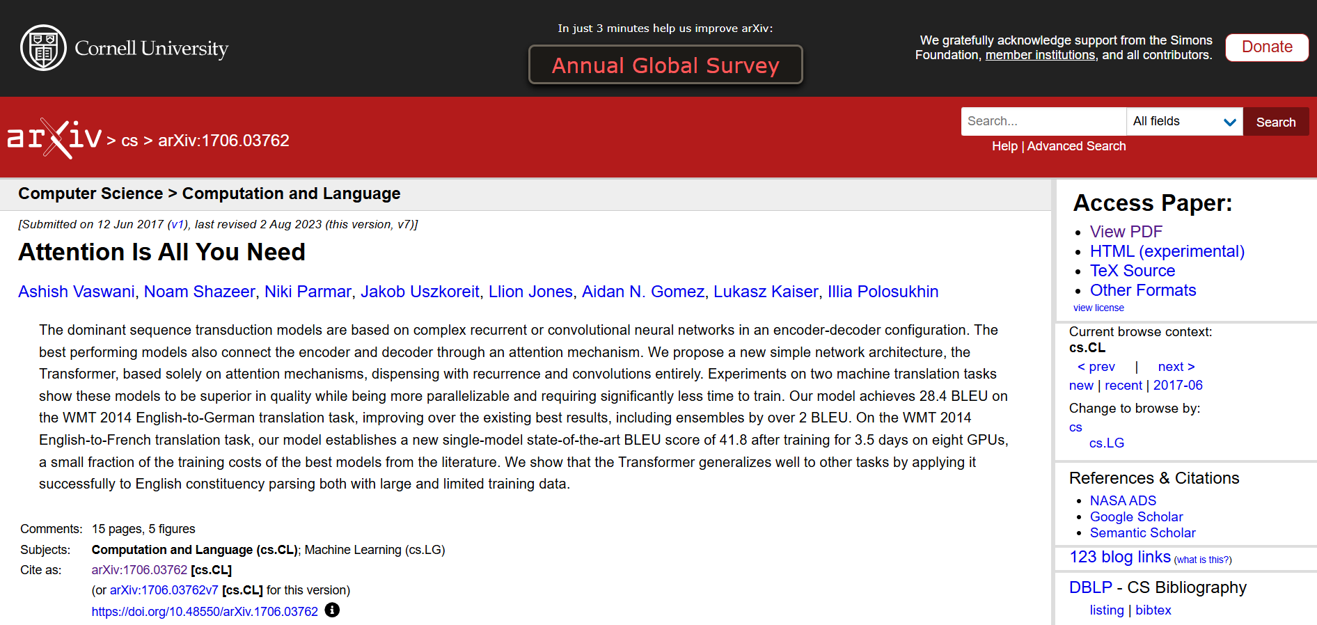
What is a Transformer?
Attention Is All You Need: https://arxiv.org/abs/1706.03762
© All rights reserved for Dr. Ryan Ahmed @Stemplicity Inc.

Slide 33
AI MODELS VISUALIZATION

Slide 34
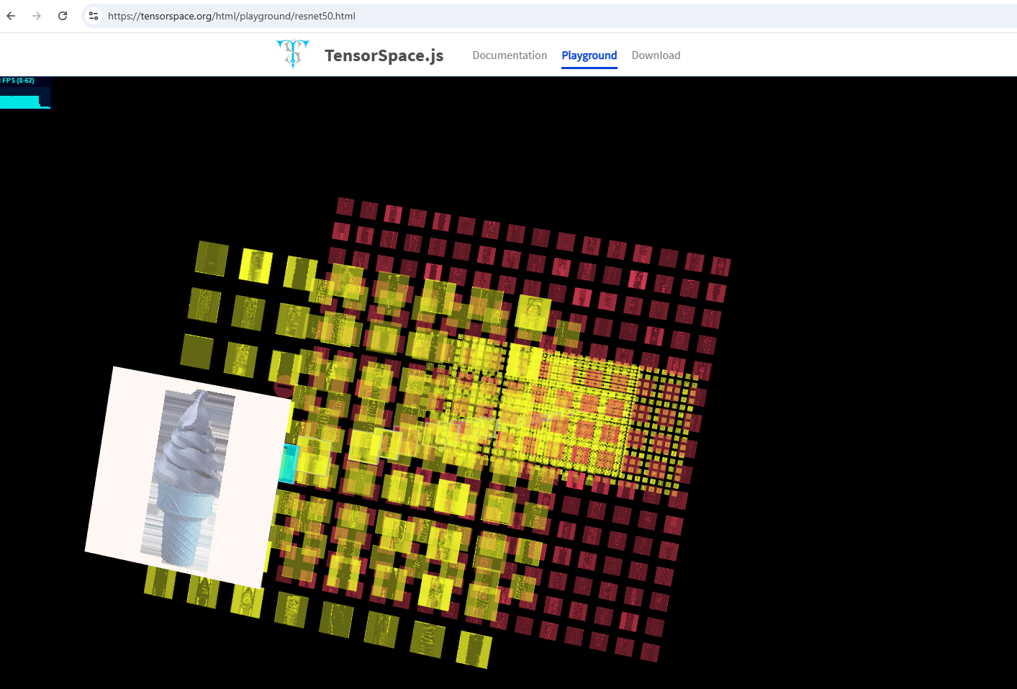
Simple AI Model Visualization
© All rights reserved for Dr. Ryan Ahmed @Stemplicity Inc.
https://tensorspace.org/html/playground/resnet50.html

Slide 35
KEY AI TERMINOLOGIES – EMBEDDINGS

Slide 36
What is Embedding?
In the context of Large Language Models (LLMs), embedding refers to a way of representing words, phrases, sentences, and documents as dense vectors of numbers.
These vectors capture the semantic meaning of the text, allowing the model to understand and work with language more effectively.
Vector Embedding:
Input Text:
“Queen”
Embedding Model
© All rights reserved for Dr. Ryan Ahmed @Stemplicity Inc.
 | [ | 9, | 7, | 8 | ]
https://www.cs.cmu.edu/~dst/WordEmbeddingDemo/tutorial.html

Slide 37
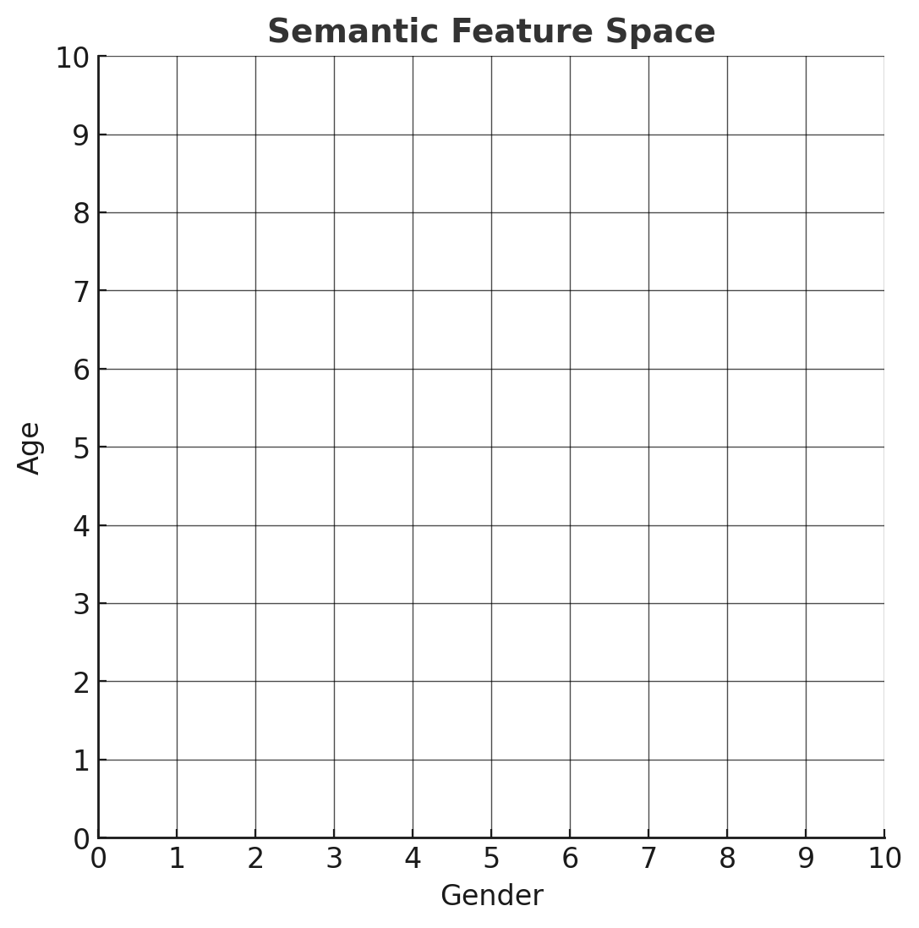
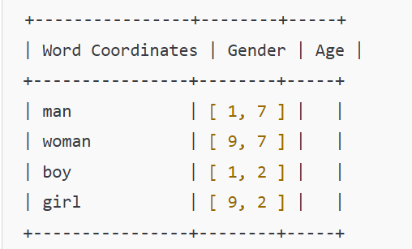
Embedding Example
Assume that we want to represent the words “man”, “woman”, “boy”, and “girl” on a semantic feature space.
On the X-axis, we have “gender”, and on the Y-axis, we have “Age”. These are called semantic features.
Not that two words refer to males, two to females, two to adults, and two to children.
man
woman
boy
girl
© All rights reserved for Dr. Ryan Ahmed @Stemplicity Inc.
https://www.cs.cmu.edu/~dst/WordEmbeddingDemo/tutorial.html

Slide 38
Quiz!
Where would you place the following words on the feature space?
“grandmother”, “child”, “grandfather”
Write down the corresponding vectors.
man
woman
boy
girl
© All rights reserved for Dr. Ryan Ahmed @Stemplicity Inc.

Slide 39
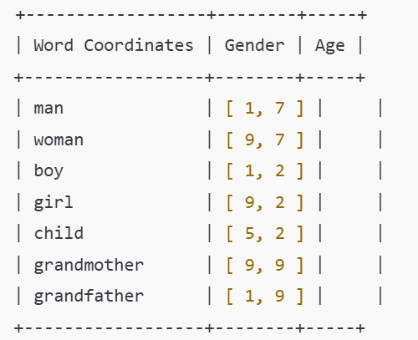
Quiz Solution!
grandfather
grandmother
Where would you place the following words on the feature space?
“grandmother”, “child”, “grandfather”
Write down the corresponding vectors.
man
woman
boy
child
girl
© All rights reserved for Dr. Ryan Ahmed @Stemplicity Inc.

Slide 40
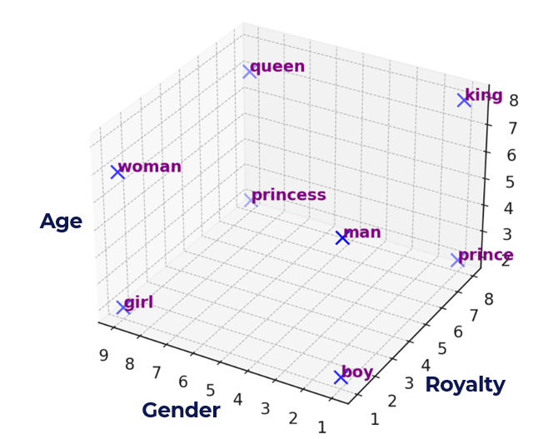
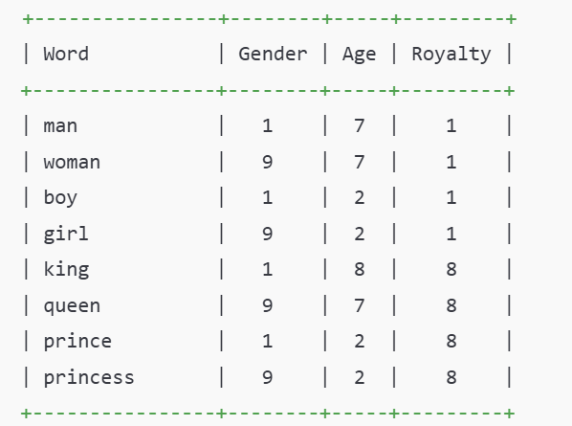
Let’s View Embeddings in 3D Space!
Let’s now look at the words “king,” “queen,” “prince,” and “princess.”
While these words share similar gender & age attributes with “man,” “woman,” “boy,” and “girl,” they have different meanings.
To distinguish “man” from “king,” “woman” from “queen,” we need to introduce a new semantic feature that sets them apart. We’ll call this feature “Royalty”. Let’s view them in a 3D space.
© All rights reserved for Dr. Ryan Ahmed @Stemplicity Inc.

Slide 41
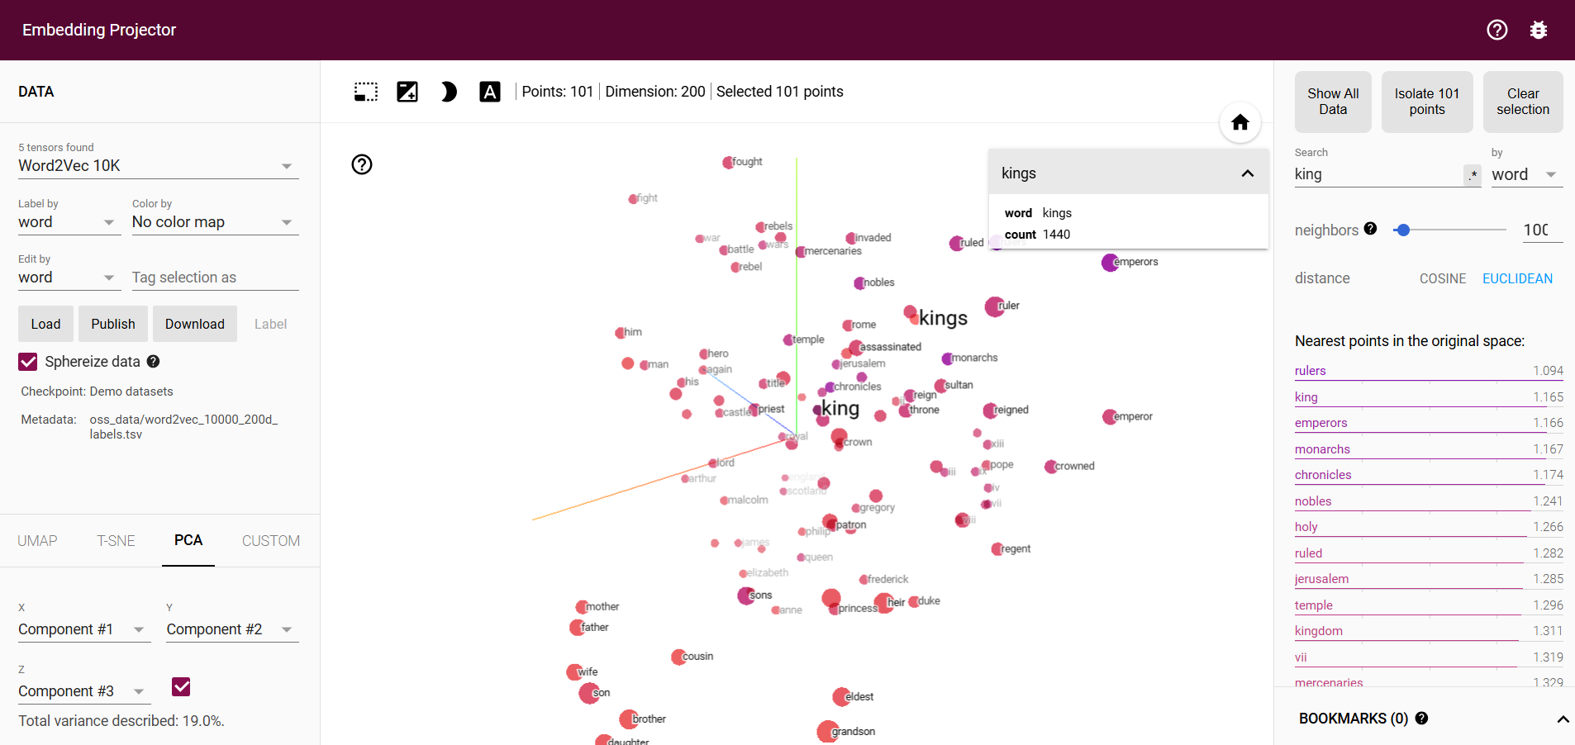
Embedding in Tensorflow
https://projector.tensorflow.org/
© All rights reserved for Dr. Ryan Ahmed @Stemplicity Inc.

Slide 42
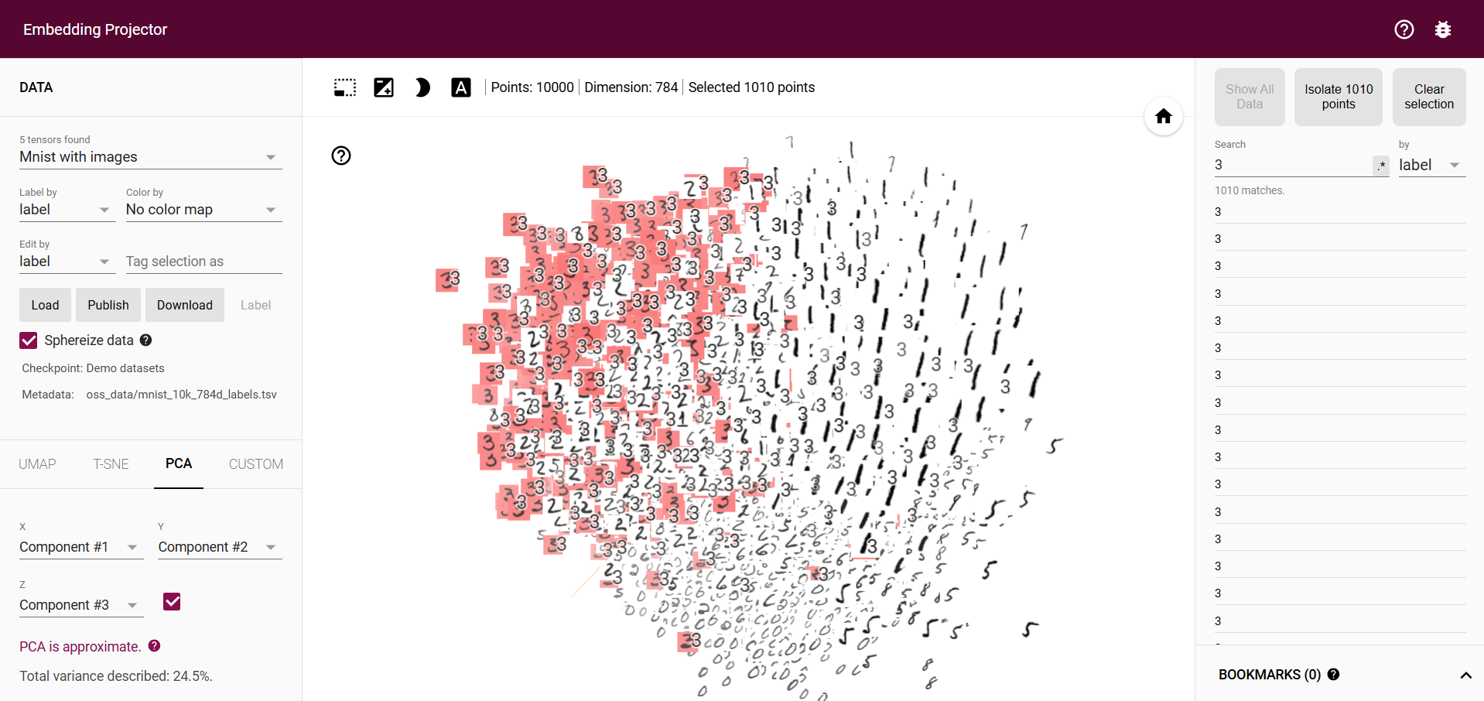
Embedding in Tensorflow
© All rights reserved for Dr. Ryan Ahmed @Stemplicity Inc.

Slide 43
OPENAI API

Slide 44
OpenAI API
The OpenAI API is a cloud-based service that provides access to OpenAI's advanced artificial intelligence models, such as GPT (Generative Pre-trained Transformer).
OpenAI offers fine-tuning capabilities to adapt the models to specific tasks or industries.
Text Generation: Generate human-like text based on prompts, enabling tasks like content creation, summarization, and question answering.
Code Generation and Debugging: Assist in writing and debugging code.
Language Translation: Translate text between different languages.
Sentiment Analysis: Understand the tone and sentiment of text.
Chatbots and Virtual Assistants: Build conversational agents for customer support.
Data Extraction: Extract structured information from unstructured data (e.g., extracting names, dates, or other entities from text).
© All rights reserved for Dr. Ryan Ahmed @Stemplicity Inc.

Slide 45

OpenAI API: How It Works?
An API (Application Programming Interface) is a set of rules and tools that allows one software application to communicate with another.
It's like a translator that enables different systems to "talk" to each other, even if they're built using different technologies or programming languages.
Example: A weather app on your phone uses an API to request the current weather data from a server (like the weather provider).
Developers send a prompt (input) to the API
© All rights reserved for Dr. Ryan Ahmed @Stemplicity Inc.
OpenAI API
The model processes the input and returns a response. This interaction is managed through simple HTTP requests.

Slide 46
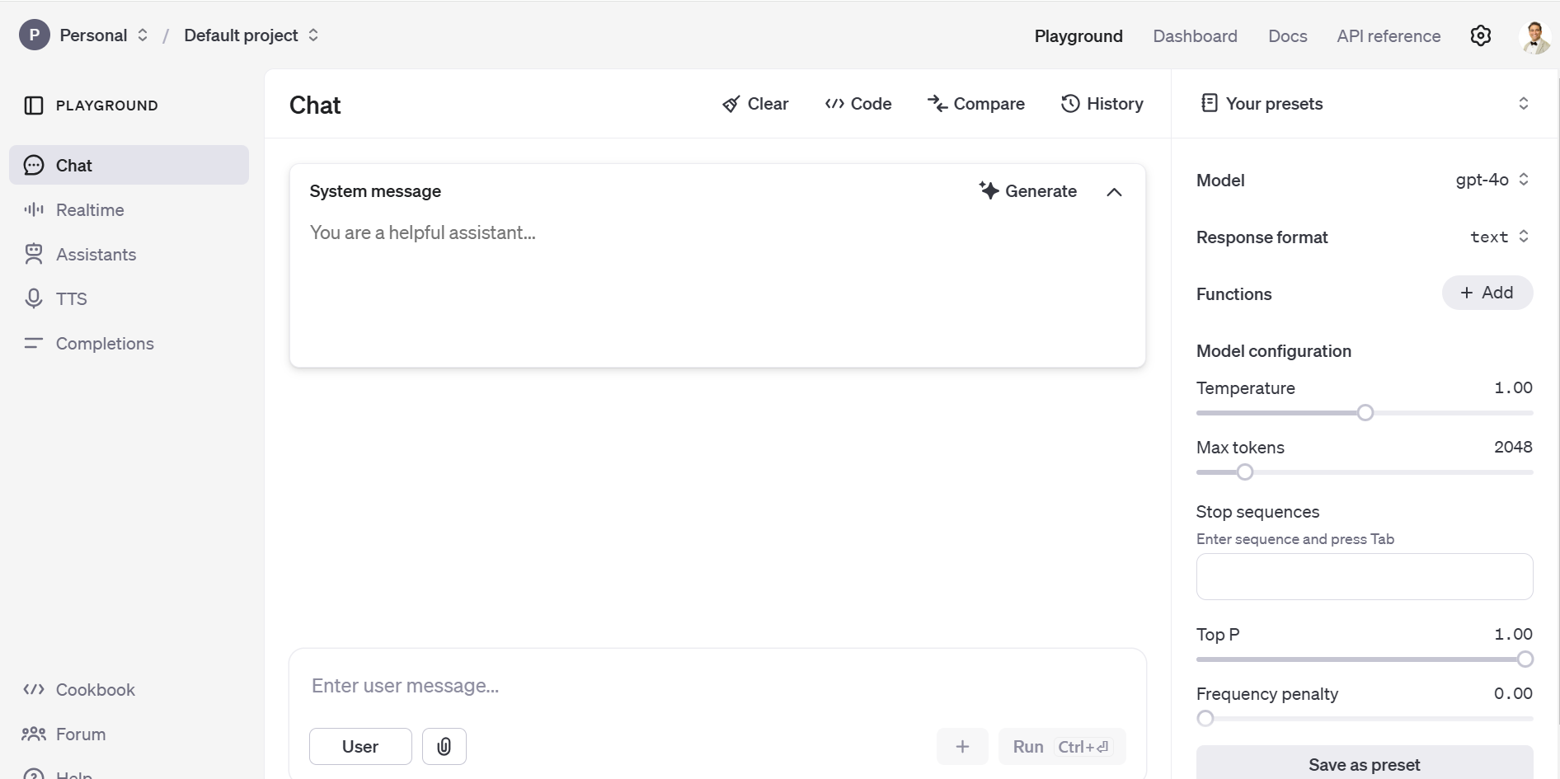
OpenAI API
© All rights reserved for Dr. Ryan Ahmed @Stemplicity Inc.
https://platform.openai.com/playground/chat?models=gpt-4o

Slide 47
System vs. User Prompt
System Prompt:
These instructions define the overall behavior and tone of the AI system.
They control how the AI responds, shaping its role, tone, and communication style.
Example: "You are a helpful assistant who explains technical concepts in simple terms."
© All rights reserved for Dr. Ryan Ahmed @Stemplicity Inc.
User Prompt:
User prompts are the questions or requests input by the user during the interaction.
They are dynamic and specific to the task the user seeks.
Example: "Explain the difference between AC and DC current."

Slide 48
System vs. User Prompt
When we add a system prompt, it establishes the overarching "personality," tone, or expertise of the AI.
This directly influences the style and focus of the responses.
Aspect | Without System Prompt | With System Prompt
Behavior | Generalized responses, context-independent. | Role-specific responses based on the system prompt.
Tone | Neutral, conversational, or simplified. | Directed, consistent with the defined role or task.
Depth | Broad and less detailed. | Detailed and precise, reflecting expertise or intent.
Focus | Balances detail and simplicity for a wide audience. | Tailored to the specific context or domain.
Consistency | Variable depending on user input alone. | High consistency, adhering to the role or persona.
© All rights reserved for Dr. Ryan Ahmed @Stemplicity Inc.

Slide 49
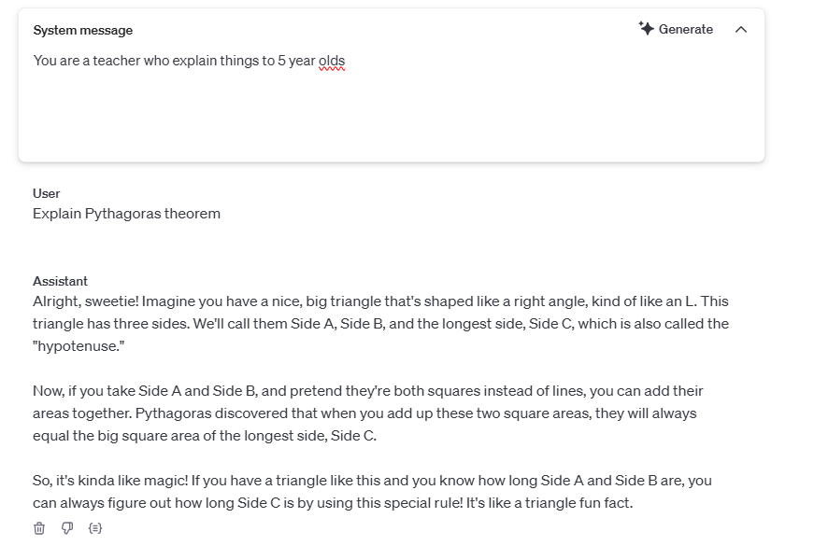
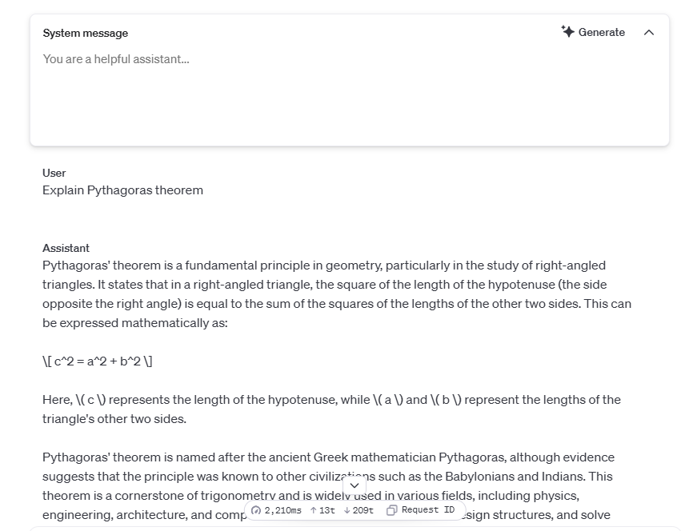
Practical Example: With and Without System Prompt
With System Prompt
Without System Prompt
© All rights reserved for Dr. Ryan Ahmed @Stemplicity Inc.
System Prompt: You are a teacher who explains things to 5-year-old
User Prompt: Explain Pythagoras theorem

Slide 50
Temperature
Temperature in natural language generation is a parameter that controls the randomness of predictions.
It affects the model's likelihood of choosing less probable options.
Temperature ranges from 0 and 2:
High temperature introduces creativity and diversity.
Low temperature ensures predictability and coherence.
© All rights reserved for Dr. Ryan Ahmed @Stemplicity Inc.

Slide 51
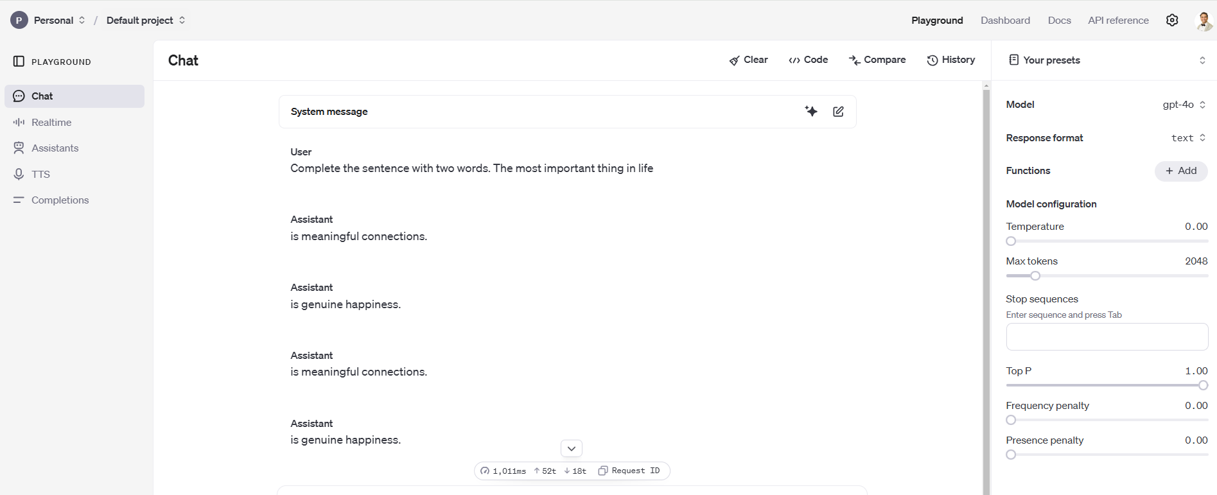
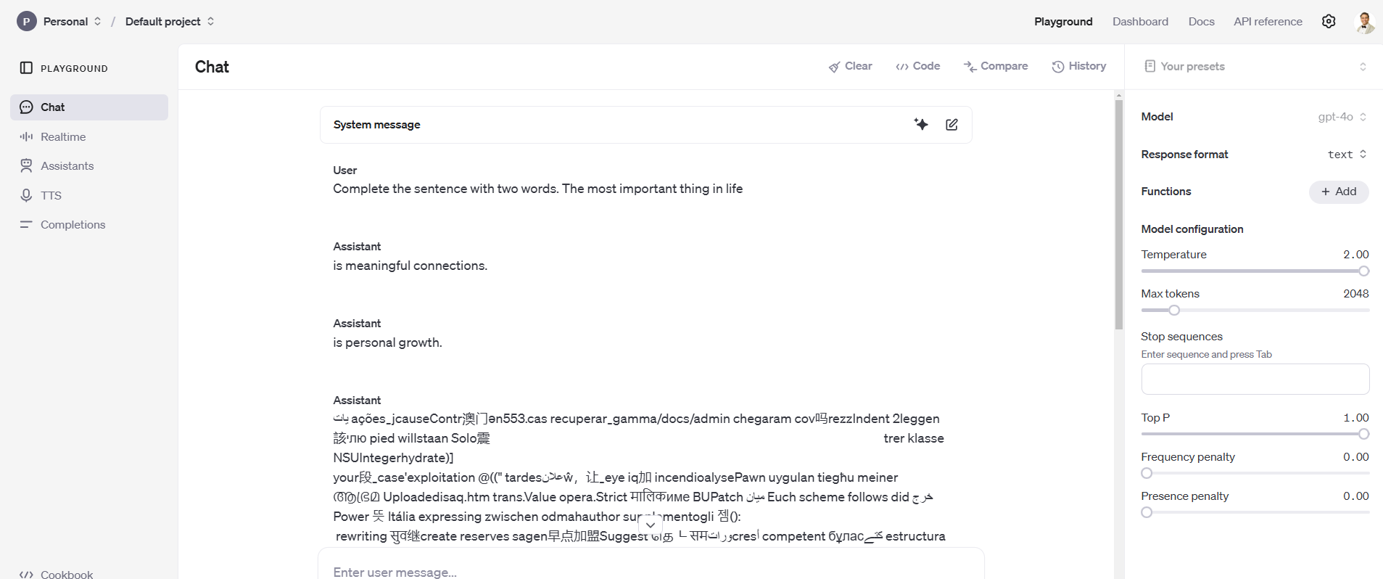
Temperature Example
Complete the sentence with two words. The most important thing in life….
Temperature = 0
Temperature = 2
© All rights reserved for Dr. Ryan Ahmed @Stemplicity Inc.

Slide 52
PRACTICAL EXAMPLE: GENAI FOR FINANCIAL DATA EXTRACTION

Slide 53
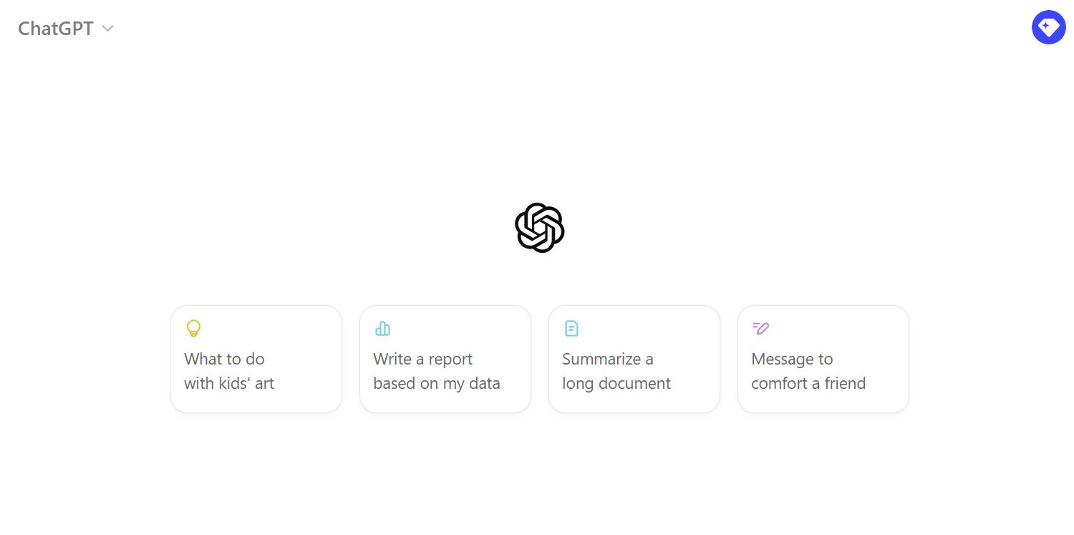
Live Demo:
🔗 Click here to explore ChatGPT ChatGPT Signup
💡 Click here for AI Prompts Explore Prompts
© All rights reserved for Dr. Ryan Ahmed @Stemplicity Inc.

Slide 54
PRACTICE OPPORTUNITY

Slide 55
Practice Opportunity
Assume that you are conducting a performance assessment on Walmart Inc.. Using the provided 10K document titled “Walmart-10K-2024.pdf”, complete the following tasks:
Upload the file to GPT4.o, extract the consolidated net income for all calendar years included in the document.
Perform a sanity check by comparing the extracted results to the 10K’s document content.
Display the results visually (any reasonable plot should be acceptable).
Analyze the 'Risk Factors' from Walmart’s 10-K filing and perform a sanity check by manually analyzing the document.
Visually display the important words in Walmart’s 10-K’s ‘Risk Factors’ section.
Summarize Walmart’s 10-K document in one page and export the results in a PowerPoint slide.
Find news articles related to Walmart’s stock performance over the past week and perform a sentiment analysis.
© All rights reserved for Dr. Ryan Ahmed @Stemplicity Inc.

Slide 56
Practice Opportunity Solutions
🔗 Click here to explore ChatGPT ChatGPT Signup
💡 Click here for AI Prompts Explore Prompts
💡 Click here for Practice Opportunities Solution Explore Prompts
© All rights reserved for Dr. Ryan Ahmed @Stemplicity Inc.

Slide 57
Thank you!

